Slide 1

THE ENDOCRINE SYSTEM
Al-Farabi Kazakh National University
Higher School of Medicine
Other Endocrine Glands

Slide 2
PART II

Slide 3
LEARNING OUTCOMES
As a result of the lesson you will be able to:
describe the structure and location of the remaining endocrine glands;
name the hormones these endocrine glands produce, what stimulates their secretion, and their functions; and
discuss the hormones produced by organs and tissues other than the classical endocrine
Al-Farabi Kazakh National University
Higher School of Medicine

Slide 4
Pre-test

Slide 5
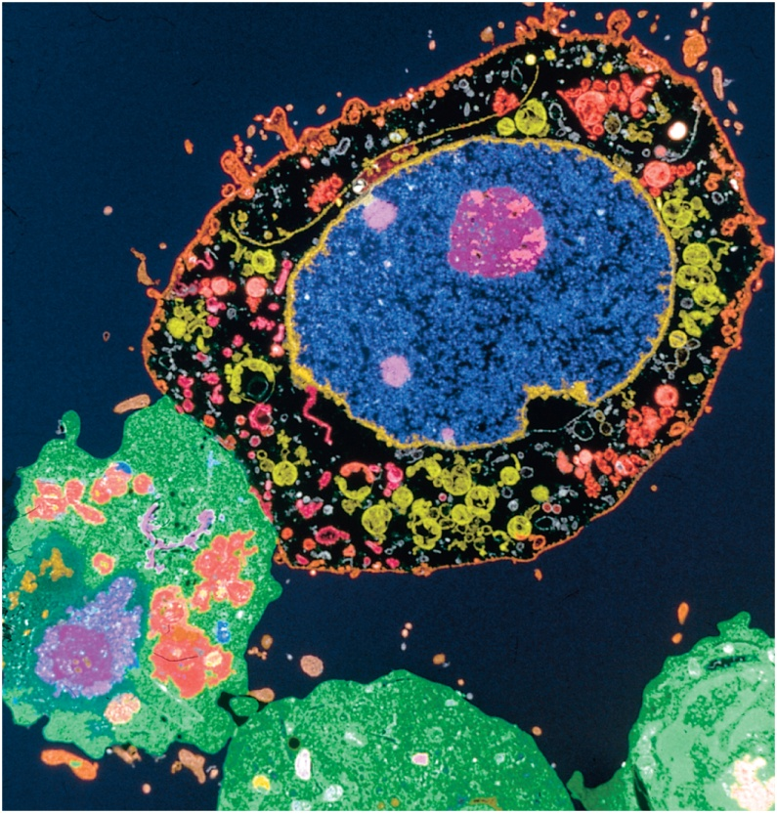
The Pineal Gland
  pine cone shape
  attached to the roof of the third ventricle of the brain, beneath the
  posterior end of the corpus callosum
- A child’s pineal gland is about 8 mm long and 5 mm wide, but after
age 7 it regresses rapidly- is called involution.
play a role in establishing 24-hour circadian rhythms of physiological function synchronized with the cycle of daylight and darkness
At night, it synthesizes melatonin, a monoamine, from serotonin.

Slide 6
The Thymus
The thymus plays a role in three systems: endocrine, lymphatic, and immune
  undergoes involution and becomes increasingly fatty and less glandular
  is a site of maturation for certain white blood cells called T cells
  It secretes several hormones (thymopoietin, thymosin, and thymulin)

Slide 7
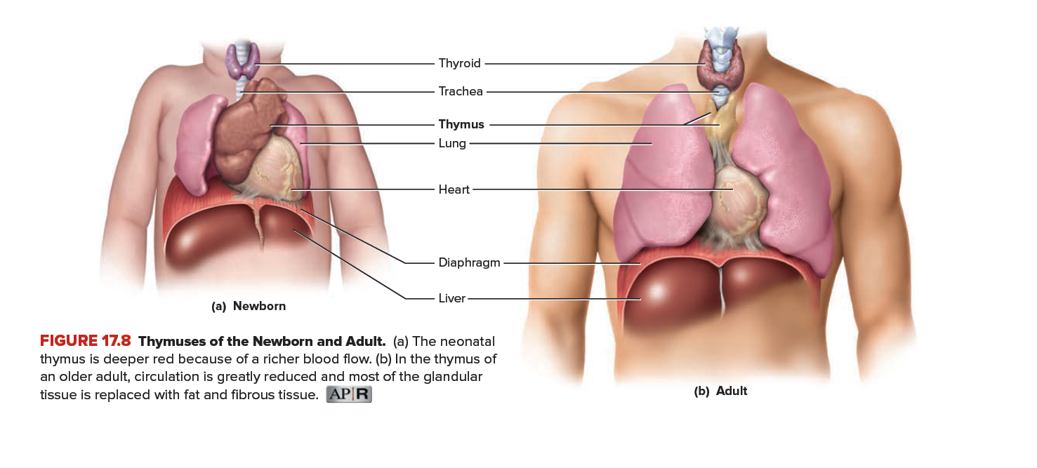
The Thyroid Gland
is the largest adult gland to have a purely endocrine function, weighing about 25 g

Slide 8
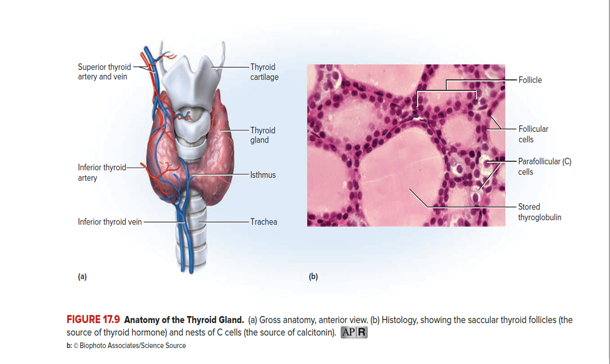
The Thyroid Gland
Histologically, the thyroid is composed mostly of sacs called thyroid follicles
  Each is filled with a protein-rich colloid and lined by a simple cuboidal epithelium of follicular cells
  These cells secrete about 80 μg of thyroid hormone (TH) daily
  90% of this is in a form called thyroxine, T4, or tetraiodothyronine its structure includes four iodine atoms
  10% is a form with three iodine atoms, called triiodothyronine or T3
  contains nests of parafollicular cells, also called clear (C) cells, at the periphery of the follicles. They respond to rising levels of blood calcium by secreting the hormone calcitonin.

Slide 9
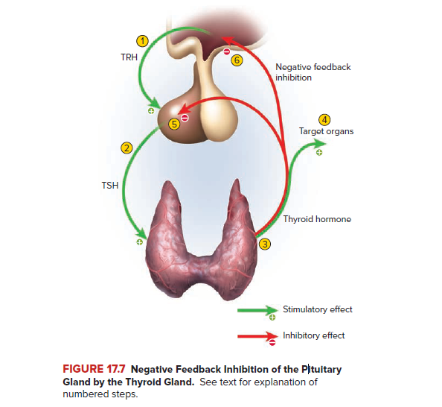
The primary effect of TH is to increase one’s metabolic rate. As a result, it raises oxygen consumption and has a calorigenic effect — it increases heat production.

Slide 10
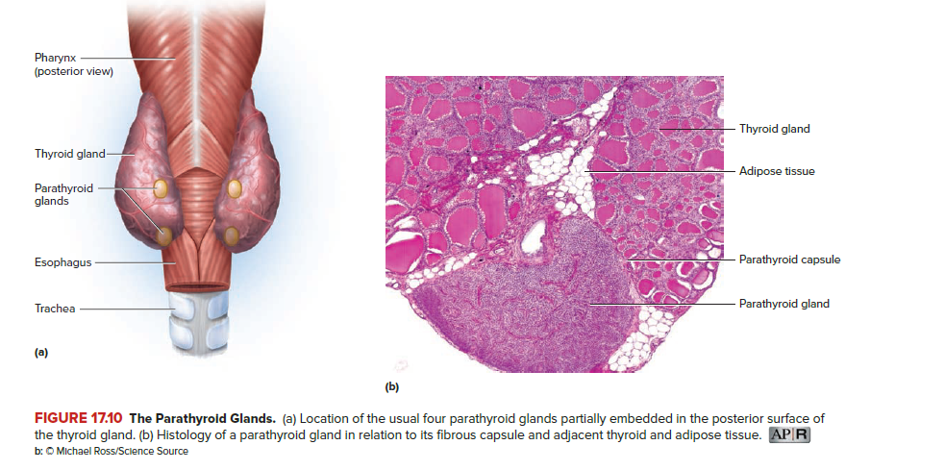
The Parathyroid Glands
are ovoid glands, usually four in number, partially embedded in the posterior surface of the thyroid.
about 3 to 8 mm long and 2 to 5 mm wide, and is separated from the thyroid follicles by a thin fibrous capsule and adipose tissue
directly monitor blood composition and secrete PTH when the calcium level dips too low.
PTH raises the calcium level by stimulating calcium reabsorption from the bones and reducing calcium losses in the urine

Slide 11
The Adrenal Glands
it like a cap on the superior pole of each kidney
retroperitoneal, lying outside the peritoneal cavity between the peritoneum and posterior body wall.
about 5 cm vertically, 3 cm wide, and 1 cm from anterior to posterior. It weighs about 8 to 10 g in the newborn, at 4 to 5 g in adults.
  the adrenal medulla, is 10% to 20% of the gland– its color ranges from gray to dark red.
  adrenal cortex, constituting 80% to 90% of the
  Gland - a yellowish color due to its high concentration of
  cholesterol and other lipids.

Slide 12
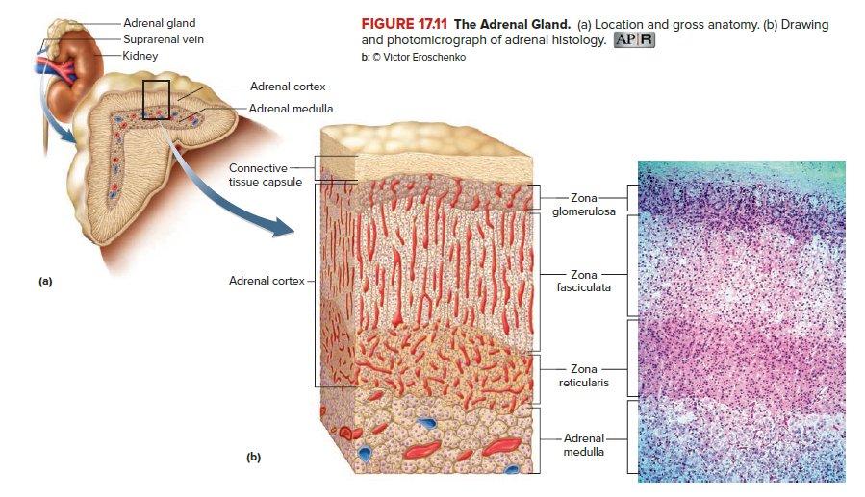
The Adrenal Glands
Valve

Slide 13
The Adrenal Medulla
The Adrenal Cortex
acting as both an endocrine
gland and a ganglion of the sympathetic nervous system
Sympathetic preganglionic nerve fibers penetrate through the cortex to reach chromaffin cells - neuroendocrine cells - release a mixture of catecholamines: about three-quarters epinephrine,
one-quarter norepinephrine, and a trace of dopamine.
surrounds the medulla on all sides
Produces more than 25 steroid hormones, known collectively as the corticosteroids or corticoids.
three categories: mineralocorticoids, which regulate the body’s electrolyte balance; glucocorticoids, which regulate the metabolism of glucose and other organic fuels; and sex steroids, with various developmental and reproductive functions.
The adrenal cortex has three layers of tissue:
The zona glomerulosa (Aldosterone)
The zona fasciculata (Cortisol, Androgens)
The zona reticularis (Cortisol, Androgens)

Slide 14
▶▶▶ APPLY WHAT YOU KNOW
The zona fasciculata thickens significantly in pregnant women. What do you think would be the benefit of this phenomenon?

Slide 15
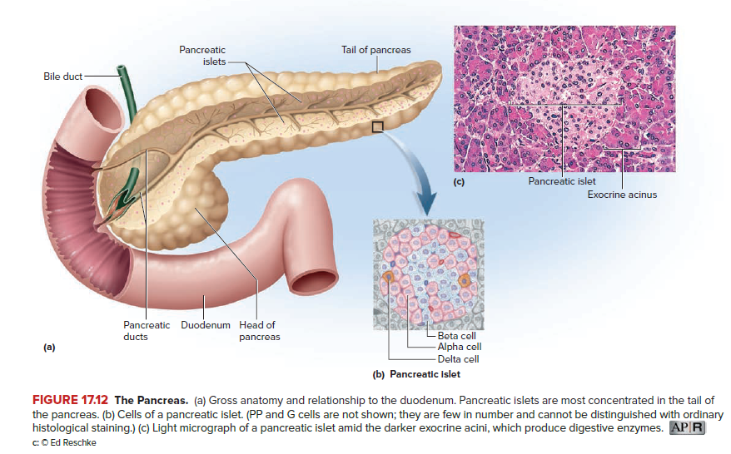
The Pancreatic Islets
The pancreas is an elongated, spongy gland located below and behind the stomach; most of it is retroperitoneal
Scattered throughout the exocrine tissue are 1 to 2 million endocrine cell clusters called pancreatic islets (islets of Langerhans21)
Alpha (α) cells, or A cells, secrete glucagon between meals when the blood glucose concentration falls below 100 mg/dL.
Beta (β) cells, or B cells, secrete two hormones, insulin and amylin.
Delta (δ) cells, or D cells, secrete somatostatin (growth hormone–inhibiting hormone) concurrently with the release of insulin by the beta cells.
Other, minor types of pancreatic cells, about 5% of the total, are called PP and G cells.

Slide 16
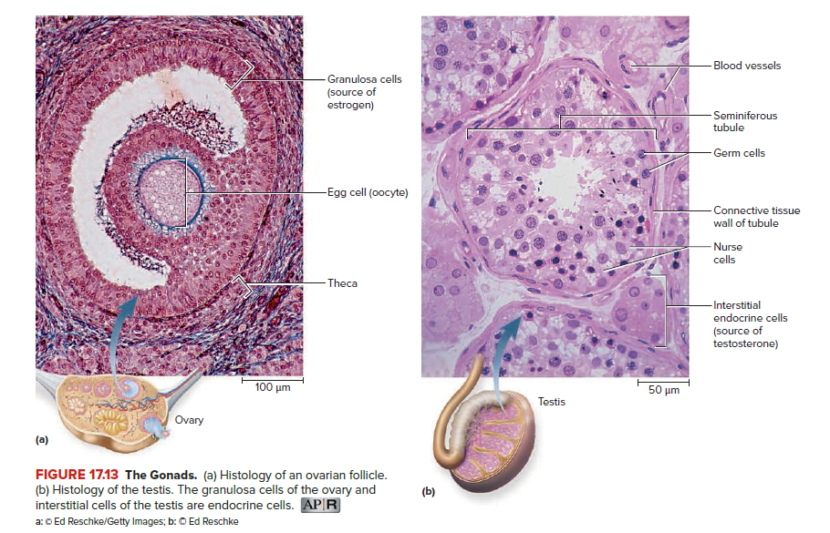
The Gonads
Ovaries and Testes are both endocrine and exocrine.
Their exocrine products are whole cells — eggs and sperm—and in this respect they are sometimes called cytogenic glands.
Their endocrine products are the gonadal hormones, most of which are steroids.
The ovaries secrete chiefly estradiol, progesterone, and inhibin. Each egg develops in its own follicle, which is lined by a wall of granulosa cells and surrounded by a capsule, the theca
The testis endocrine secretions are testosterone, lesser amounts of weaker androgens and estrogens, and inhibin. Inhibin comes from nurse cells that form the walls of the seminiferous tubules.

Slide 17
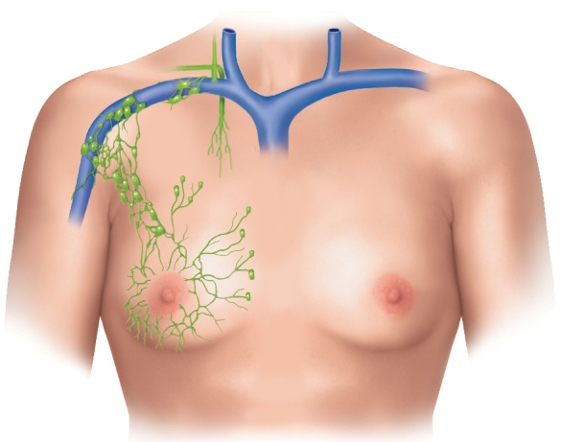
Lymphatic Drainage of Mammary and Axillary Regions
Why are the axillary lymph nodes often biopsied in cases of suspected breast cancer?
Copyright © The McGraw-Hill Companies, Inc. Permission required for reproduction or display.
Right lymphatic duct
Right subclavian
vein
Axillary lymph
nodes
Lymphatics
of breast
(b)
Figure 21.6b

Slide 18
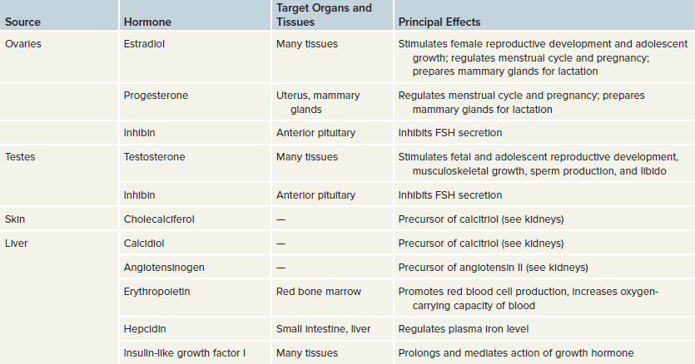
Endocrine Functions of Other
Tissues and Organs

Slide 19
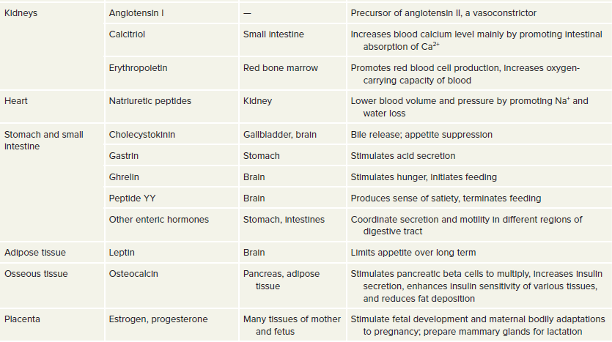
Endocrine Functions of Other
Tissues and Organs

Slide 20
Post-test

